Slide 1
Blind Deblurring Using Internal Patch Recurrence
GROUP 3:
Yifeng Huang, Zijian Qiao
Yunzhe Cao, Shangru Huang

Slide 2

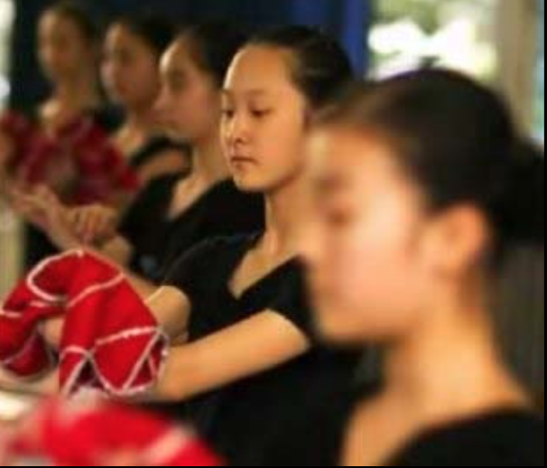

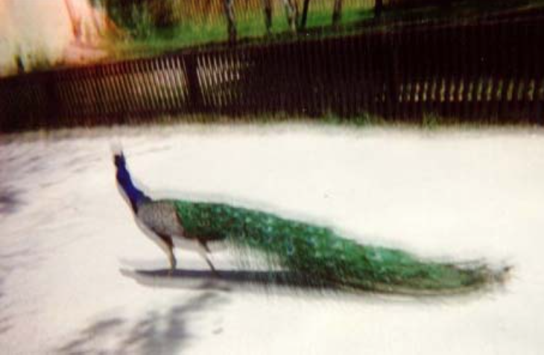
Types of blur
Moving object
Out of focus with different depth of field
Out of plane
Hand shake

Slide 3

Deblur的图形前提assumption
Hand shake blur / out of focus blur with little depths of fields

Slide 4
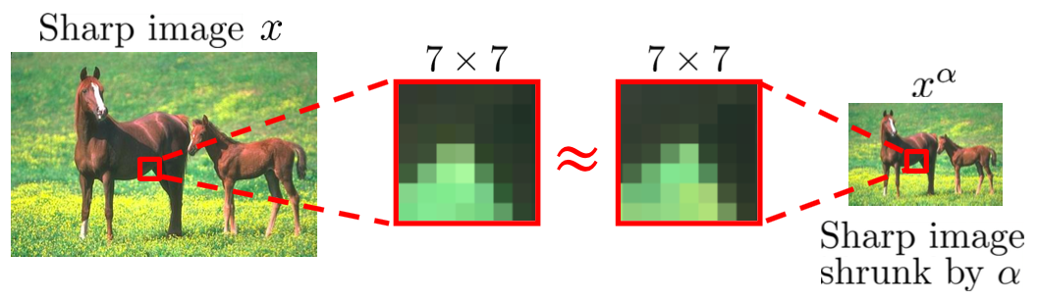
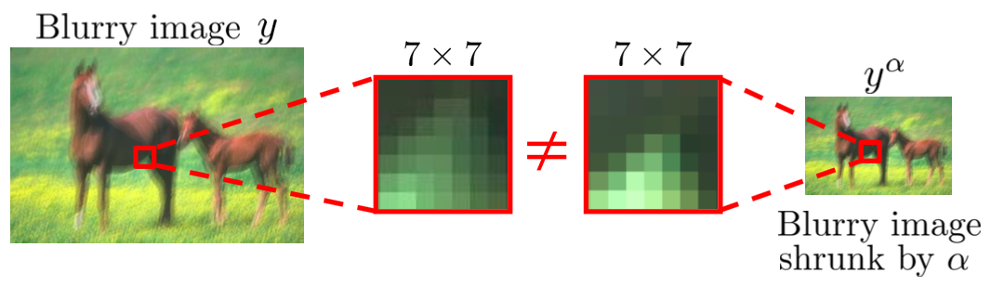
Internal Patch Recurrence
Patch recurrence across scales in a sharp image
In a blurry image, cross-scale patch recurrence deminishes

Slide 5
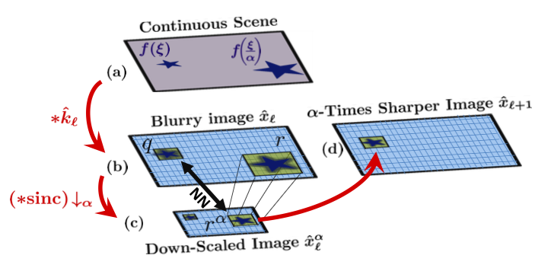
T. Michaeli and M. Irani
Step 1: Down scale Find nearest neighbor (NNs)

Slide 6
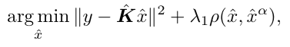
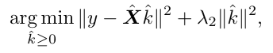
T. Michaeli and M. Irani
Step 2: Deblurring Using Internal Patch Recurrence
Step 3: Kernel Update

Slide 7

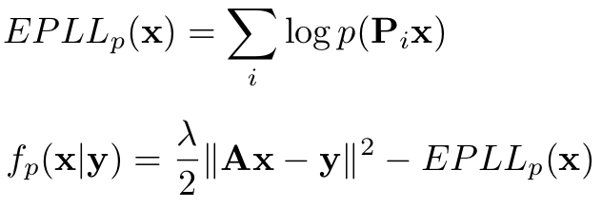
D. Zoran and Y. Weiss
Learn Prior
Restore image by maximizing Expected Patch Log Likelihood (EPLL)

Slide 8
epll的比较

Slide 9
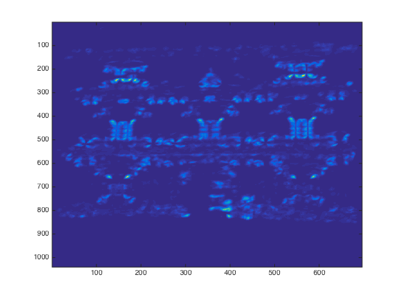

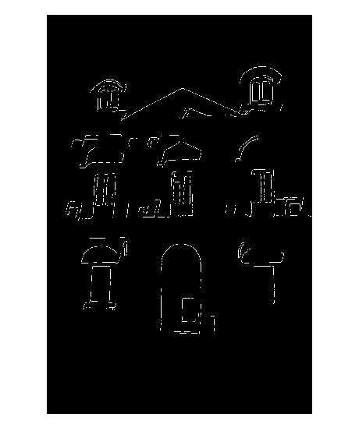
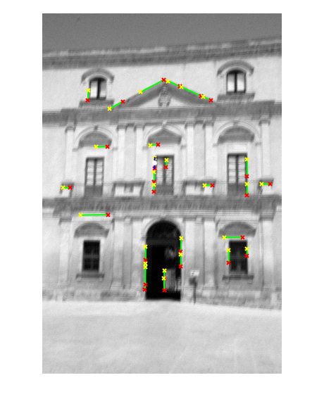
Auto crop to get good regions
1, Get line segments: canny edge detector and hough transform
2, Detect corners: minimum eigenvalue corner detector
3, Give weight to each line segment

Slide 10
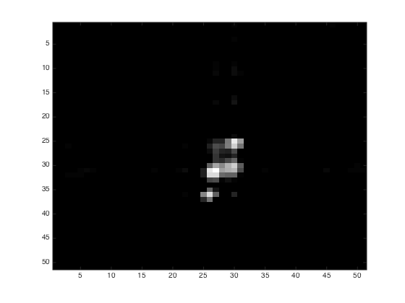
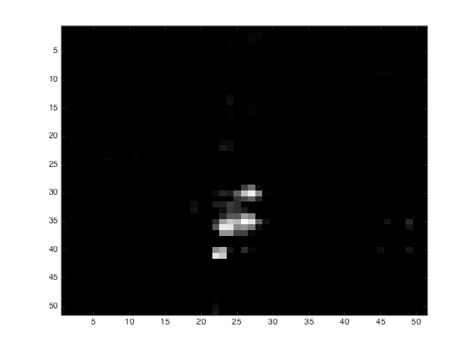
Auto crop to get good regions
Whole image
Cropped image

Slide 11
motion跑几张图

